Slide 1
Development of Climate Smart Agriculture and Climate Information System Relevant Curricula for Staff, Students and other stakeholders in Universities in Africa
Professor KONE Daouda
Director WASCAL Capacity Building Department
July 12⁻15th2022

Slide 2
West
African
Science Service
Centre on Climate Change and
Adapted
Land Use
WASCAL is a large-scale Education, Research-focused and Climate Service Centre designed to help tackle this challenge and thereby enhance the resilience of human and environmental systems to climate change
Funded by the German Federal Ministry of Education and Research (BMBF), WASCAL is implemented in a collaborative effort by 11 West African countries and German partners.
Created at 2009
Schools established at 2012
Endorsed by ECOWAS in 2014

Slide 3
Services delivering
Seminars
Short Course Training
(SCT)
SHORT COURSES
Training of trainier of 9 countries of ABN (Niger Basin Authority)

Slide 4
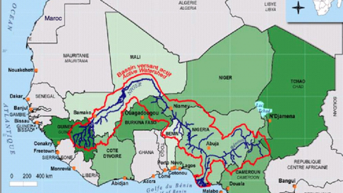
Services delivering
CAPACITY BUILDING OF TRAINERS ON ADAPTATION TO CLIMATE CHANGE IN THE 9 COUNTRIES OF NIGER BASIN
Benin​, Burkina Faso, Tchad Cameroun, Côte d'Ivoire, Guinea, Mali, Niger, Nigeria
Module 1 : (GIRE) Integrated Management of Water Resources24
Module 2 : Analyse of activities related to agriculture, livestock production, fishering, wild animal and mining to climate change and developement of adaptation option
Module 3 : Approaches and techniques for degraded lands, banks and forest landscapes restauration
Module 4 : Consideration of Gender issue in project preparation and implementation

Slide 5
Services delivering
CAPACITY BUILDING OF TRAINERS ON ADAPTATION TO CLIMATE CHANGE IN THE 9 COUNTRIES OF NIGER BASIN
Benin​, Burkina Faso, Tchad Cameroun, Côte d'Ivoire, Guinea, Mali, Niger, Nigeria
Module 1 : (GIRE) Integrated Management of water resources
Module 2 : Analyse of activities related to agriculture, livestock production, fishering, wild animal, mining to climate change and developement of adaptation option
Module 4 : Consideration of Gender issue in project preparation and implementation
Module 3 : Approaches and techniques for degraded lands, banks and forest landscapes restauration

Slide 6
CASCADE TRAINING CAPACITY BUILDING FOR ADAPTATION AND RESPONSE OF PIDACC/BN STAKEHOLDERS IN TERMS OF CLIMATE CHANGE
En vert : mis en œuvre par WASCAL-UAM
List
1
Dates et places
Module 1- Benin
Module 2-Niger
Module 3- Côte d’ivoire
Module 4- Ouagadougou
Training of trainers
(VC, Dean, Lecturers)
Nécessité d’avoir la liste des personnes à former
2
3
Training of trainers
(VC, Dean, Lecturers)
Cible 1: cadres techniques
Cible 2 : experts des Unités spécialisées
Beneficiaires
Communication du planning des
formations répliquées par les formateurs: Tableau De Board
Déploiement de la formation
Cible a connaitre
4
4
Formations des acteurs ABN
+ if coaching nécessaire ABN de discuter avec WASCAL et UAM
Formations des acteurs ABN
Duplication par les personnes formées, autant de fois que nécessaire pour former 4 millions de petits producteurs (trices) dans les neuf (9) pays du bassin du Niger dont 51% de femmes
Notes:
6

Slide 7
CASCADE TRAINING FOR CSA AND CIS IN UNERSITIES CURRICULA
stakeholders
1
Training of trainers
(VC, Dean, Lecturers)
Training modules developed
2
3
Training of trainers
(VC, Dean, Lecturers)
Target 1: VC Deans, Lecturers
Target 2 : extension service- practionners
Beneficiaries
Communication use partnership
Upscaling -dissemination
4
4
Training of learners (Bachellor-Master and PhD students
Implementation of short courses
+ if coaching
Dissemination CSA and CIS in core Universities curricula and other WASCAL countries
Notes:
7

Slide 8
Thank you

